Slide 1
Business Support FAQs
(For Customer Use)
[REV 2.3.22]

Slide 2

Business Support Contact Information
Telephone: 888-325-5875 Opt. 3
Submit a Ticket: broadvoice.com/submit-a-ticket/
Chat: broadvoice.com/contact-us/
Hours of Operation:
24 x 7 x 365. Support is open every day, all day including holidays.
Business Support Contact Information
Please note that cases are worked as they come in, regardless of the time of day, as we offer 24 x 7 support. But non-urgent issues that may require additional support are worked to a 24-hour SLA.
We’re happy to help, and please be assured that we have trained technicians to support our business customers after-hours, weekends, and holidays.

Slide 3
SUPPORT LEVELS
What Support Levels do you offer?
We offer three support levels with a special handling of Premier accounts, see below:
TIER 1:
The issue is reported, call samples extracted, issues a case and explains the troubleshooting process to the customer. Depending on the reported problem. The SLA is within 24 hours of receipt. If the issue is service affecting, it is immediately routed to the next level.
TIER 2:
The reported issue is investigated and worked on to resolve. The customer will be asked to retest, or if more info is needed to resolve, the customer will be contacted. SLA is the same day as received.
PREMIER CARE:
If an account is assigned a Premier Account status, the SLA to respond to an incident is within 2 hours of receipt. Premier cases are automatically assigned a Tier 2 or above technician.
Note: Premier customers will be given a dedicated direct Premier Support Number
What is the SLA for Cases?
For Non-Service Impacting issues = the SLA is 24 hours upon receipt
Service Impacting = the SLA is immediate (if services are down, updated every 30 minutes)
For Premier Accounts = the SLA is 2 hours within receipt
Notes:
Goals
Remove passwords from Broadvoice databases
Decrease support time on user login / password management
Decrease in number of failed login attempts to 9%
Improve customer onboarding experience
Leverage partnership with world class provider to stay current with login security threats and future integration capabilities

Slide 4
How do I escalate an issue?
Email: support-escalations@broadvoice.com
Please Note: Call or respond to the case itself to request an escalation at any time if you feel the issue isn’t resolved. Please provide case number, description of the issue and reason for escalation.
Hours: 6:00 am PST – 5:45 pm PST (Monday – Friday) *
SLA: 1 hour within receipt to acknowledge request
Follow Up: Supervisors will provide continuous updates until the reported issue is resolved and confirmed to be resolved.
Escalation Process
*The support escalation email is staffed during the business hours noted above.
For escalated or for any issues reported that are outside of the escalated staffed hours noted above, please call 888-325-5875 Opt. 3 for immediate service.
For any service impacting issue please do not email instead call our support line at 888-325-5875 Opt. 3.
Our Support Center is available 24 hours, 7 days a week, including holidays.

Slide 5
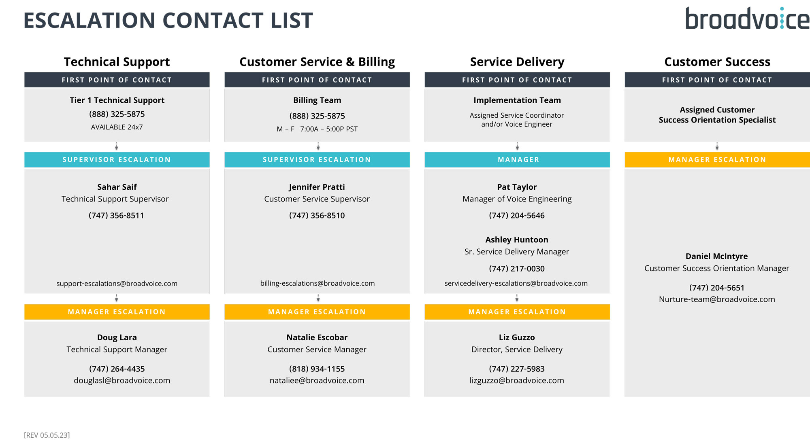

Slide 6

THANK YOU

